Slide 1
Daily activities
Área Académica: Licenciatura en Ingeniería Industrial
Profesor(a): L.E.L.I Leticia Sánchez Franco
Periodo: Enero – junio 2016

Slide 2
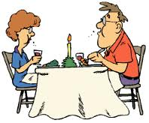
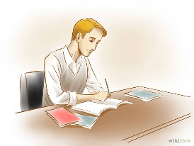
take a shower
have breakfast
get up
leave home
go to bed
What time do you …?
start work/ classes
watch the news
have lunch
have dinner
get home
do your homewok

